Slide 1

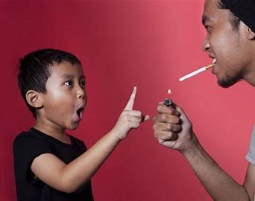
Analyzing Adolescent Tobacco Consumption Patterns
Team Members: Mereissa Henrie, Derilee Walters, Love Lorissaint, Sacide Belair
Mereissa
Notes:
Good evening, everyone my name is Mereissa and this is out team's project. We will be discussing what we found while Analyzing adolescent tobacco consumption patterns.

Slide 2
Description/Outline:
The project attempts to determine how youngsters across the United States are using tobacco, unravel the most common types of smoking products they favor the most and in which states usage rates are higher, representation of current smoking status, and establishes smoking patterns by education and gender, as these indicators are also vital.
The dataset is drawn from (CSV file: https://www.kaggle.com/datasets/sahirmaharajj//youth-tobacco-survey) and was reworked, cleaned, and broken into manageable pieces with detailed analyses and visualizations.
Mereissa
Notes:
So our project attempts to determine…
The dataset is drawn from this CSV file and was ….

Slide 3
Clean Data Process:
Identify and remove duplicate rows if they exist.
Correct data types
Ensure that each column has the correct data type
Identify missing or null values in the dataset
Love

Slide 4
Questions:
What are the most frequently used tobacco products among young people?
Geographic: is there a correlation between state and reduced rates of youth tobacco usage?
What is the current measure of youth smoking status in the past based on educational level and gender?
Mereissa
Notes:
Here are the questions that we aim to answer. . . .

Slide 5
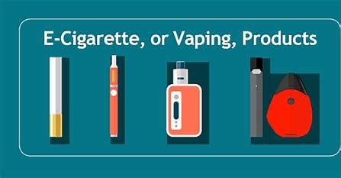
Questions One:
What are the most frequently used tobacco products among young people?
Derilee

Slide 6
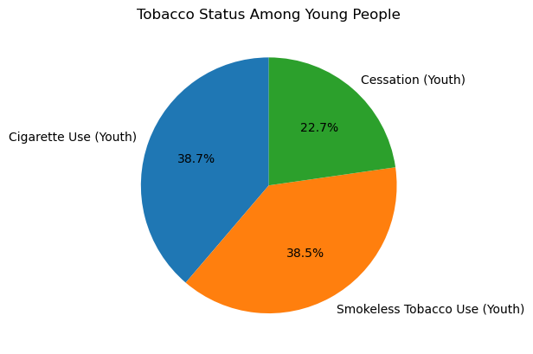
Derilee

Slide 7
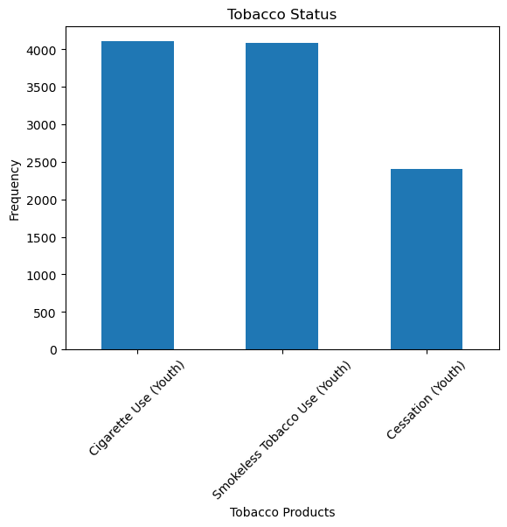
Derilee

Slide 8
Questions One findings:
38.7% of young individuals preferred cigarettes over smokeless tobacco. While 38.5% of them picked smokeless tobacco and 22.7% of young individuals were shown to have quit smoking. The frequency between both smokeless and cigarettes are relatively the same amount.
Derilee

Slide 9
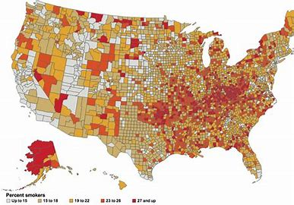
Questions Two:
Geographic: is there a correlation between state and reduced rates of youth tobacco usage?
Love

Slide 10
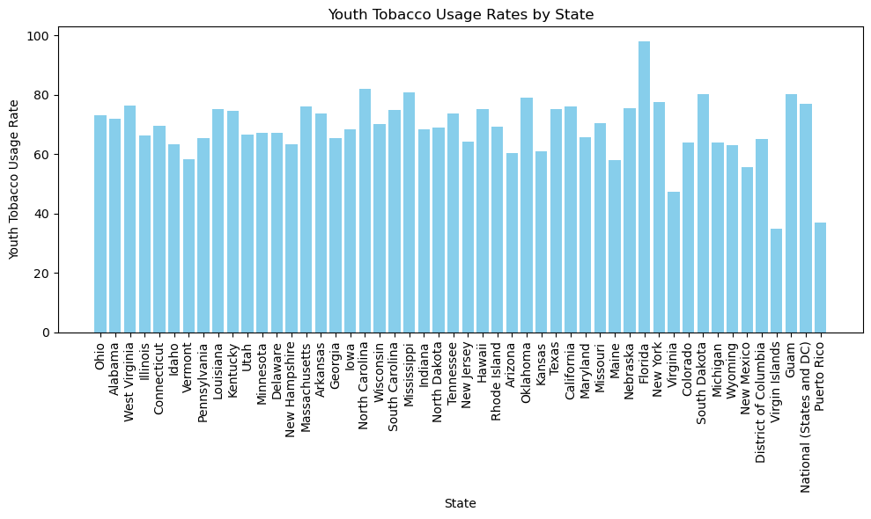
Love

Slide 11
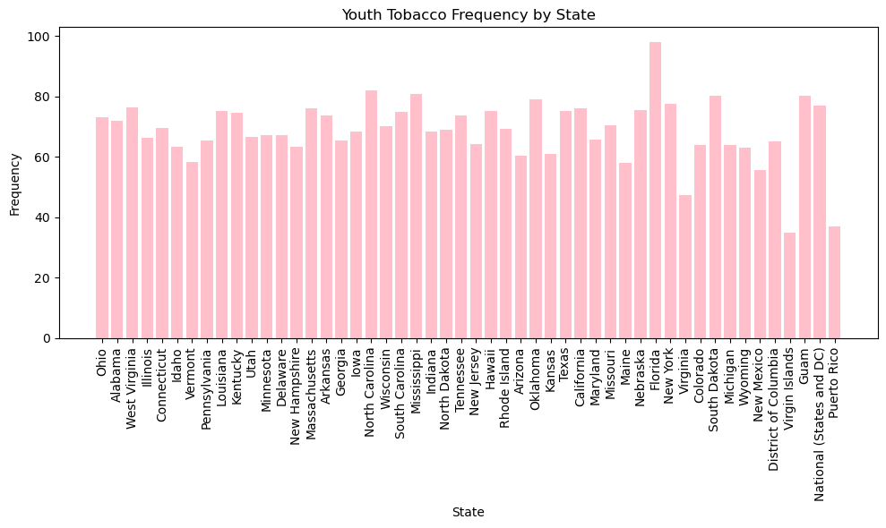
Love

Slide 12
Questions Two Findings:
The state of Florida has the highest usage rate at 97% and frequency among the states and The Virgin Islands has the lowest usage rate at 40%.
The state of Florida also has the highest level of smoking frequency at 95 and the lowest is Virgin Islands at 38.
Sacide

Slide 13
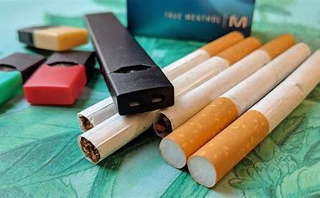
Questions Three:
What is the current measure of youth smoking status in the past
Based on educational level and gender?
Sacide

Slide 14
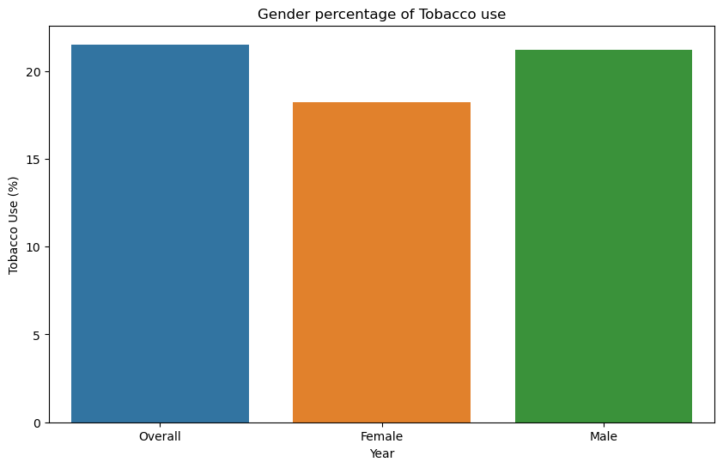
Sacide

Slide 15
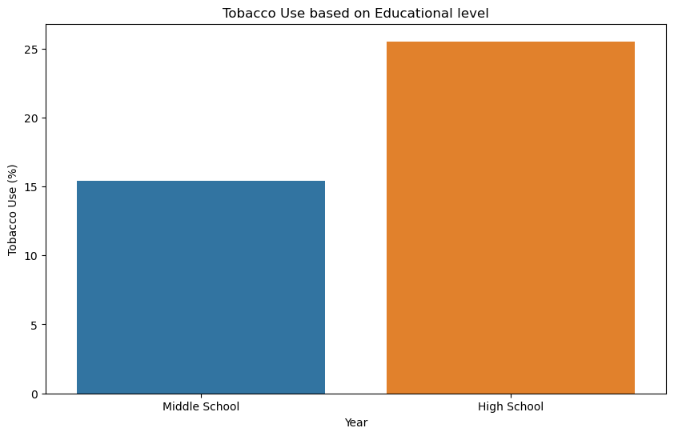
Sacide

Slide 16
Questions Three findings:
Male smokers were found to have 5% more smokers then females.
High school students were found to have the highest rates compared to middle schoolers by 10%.
Sacide

Slide 17
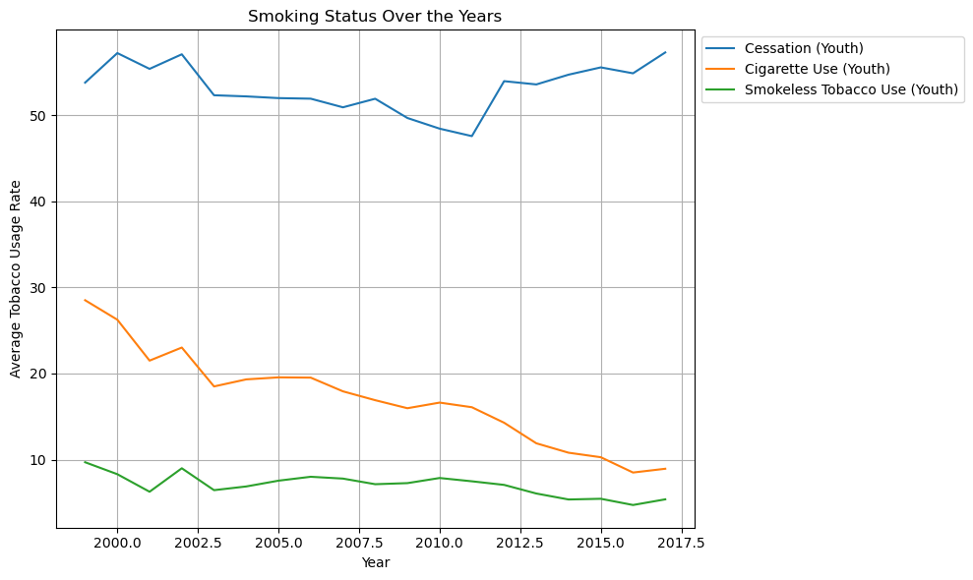
Smoking Status over 17 Years:
Love

Slide 18

Analysis and Conclusion:
In conclusion, we found the geographic variations in youth tobacco products based on rates and frequency. The historical smoking status of youngsters over 17-year period. We noticed the smoking preferences are the highest among high schoolers and male students. We have effectively analyzed the correlation of rates among U.S. states and U.S. territories using visuals and data we found that Florida had the highest rates of smoking and frequency. Also, we have evaluated our visuals and data with findings of cessation rates to be growing over the 17 years, based on gender and educational levels.
Questions?
Mereissa
Notes:
Pending any questions this concludes our presentation

